Slide 1


ARTIFICIAL INTELLIGENCE Lab-II Program 4 Naïve Bayes theorem
Dayananda Sagar University
School of Engineering, Hosur Main Road, Kudlu Gate, Bengaluru-560 068
20AM3602
SEMESTER – VI
Course Code: 20AM3602
Prof. Pradeep Kumar K
Dept. of CS&E (AIML)
DSU, Bangalore

Slide 2
Naïve Bayes Theorem
20AM3602
Bayes theorem is one of the earliest probabilistic inference algorithms developed by Reverend Bayes (which he used to try and infer the existence of God no less) and still performs extremely well for certain use cases.
It is a classification technique based on Bayes’ Theorem with an assumption of independence among predictors. In simple terms, a Naive Bayes classifier assumes that the presence of a particular feature in a class is unrelated to the presence of any other feature. For example, a fruit may be considered to be an apple if it is red, round, and about 3 inches in diameter. Even if these features depend on each other or upon the existence of the other features, all of these properties independently contribute to the probability that this fruit is an apple and that is why it is known as ‘Naive’.

Slide 3
BAYES THEOREM IMPLEMENTATION
20AM3602
Let's say we are trying to find the odds of an individual having diabetes, given that he or she was tested for it and got a positive result. In the medical field, such probabilies play a very important role as it usually deals with life and death situatuations.

Slide 4
20AM3602
P(D) is the probability of a person having Diabetes. It's value is 0.01 or in other words, 1% of the general population has diabetes(Disclaimer: these values are assumptions and are not reflective of any medical study).
P(Pos) is the probability of getting a positive test result.
P(Neg) is the probability of getting a negative test result.
P(Pos|D) is the probability of getting a positive result on a test done for detecting diabetes, given that you have diabetes. This has a value 0.9. In other words the test is correct 90% of the time. This is also called the Sensitivity or True Positive Rate.
P(Neg|~D) is the probability of getting a negative result on a test done for detecting diabetes, given that you do not have diabetes. This also has a value of 0.9 and is therefore correct, 90% of the time. This is also called the Specificity or True Negative Rate.

Slide 5
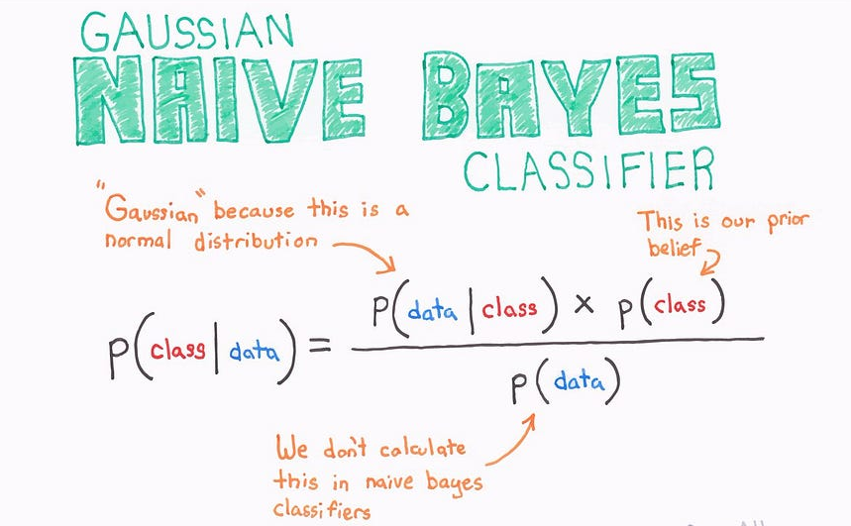
20AM3602

Slide 6
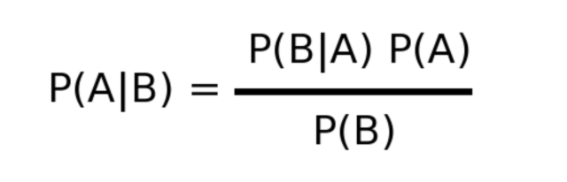
The Bayes formula is as follows:
20AM3602
P(A) is the prior probability of A occuring independantly. In our example this is P(D). This value is given to us.
P(B) is the prior probability of B occuring independantly. In our example this is P(Pos).
P(A|B) is the posterior probability that A occurs given B. In our example this is P(D|Pos). That is, the probability of an individual having diabetes, given that, that individual got a positive test result. This is the value that we are looking to calculate.
P(B|A) is the likelihood probability of B occuring, given A. In our example this is P(Pos|D). This value is given to us.

Slide 7
20AM3602
Putting our values into the formula for Bayes theorem we get:
P(D|Pos) = (P(D) * P(Pos|D) / P(Pos)
The probability of getting a positive test result P(Pos) can be calulated using the Sensitivity and Specificity as follows:
P(Pos) = [P(D) * Sensitivity] + [P(~D) * (1-Specificity))]

Slide 8
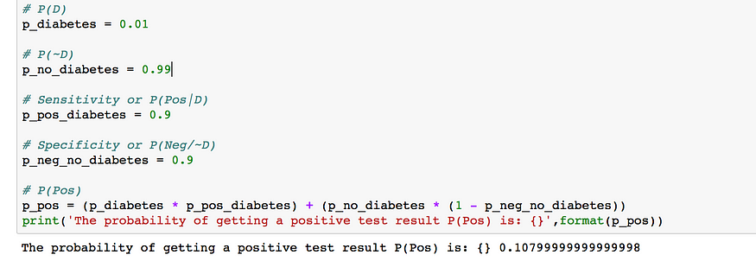
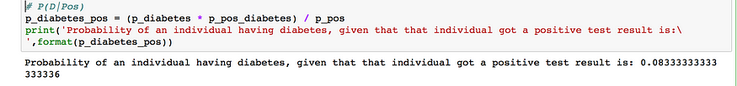
20AM3602

Slide 9
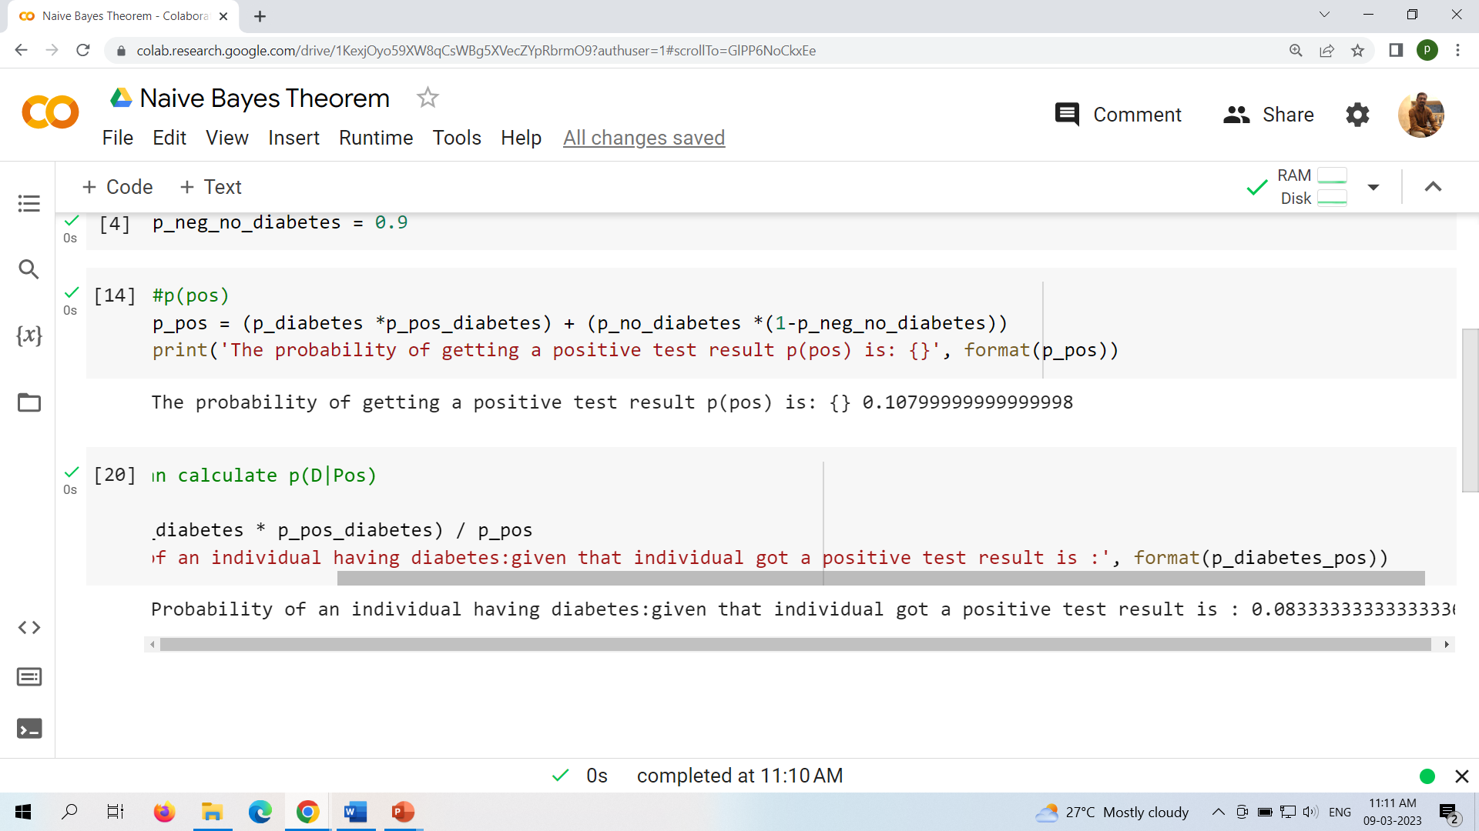
20AM3602

Slide 10
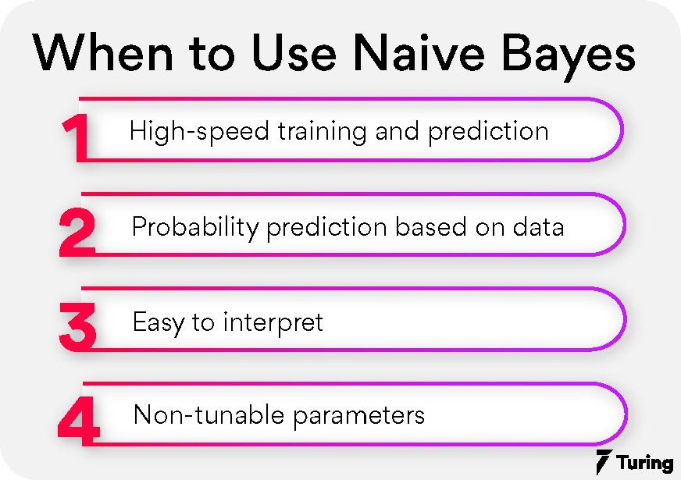
Implement naïve bayes theorem to classify the English text
20AM3602

Slide 11
Implement naïve bayes theorem to classify the English text
20AM3602
Text Analysis is a major application field for machine learning algorithms. However the raw data, a sequence of symbols (i.e. strings) cannot be fed directly to the algorithms themselves as most of them expect numerical feature vectors with a fixed size rather than the raw text documents with variable length.

Slide 12
Naive Bayes algorithm
20AM3602
Naive Bayes classifiers are a collection of classification algorithms based on Bayes’ Theorem. It is not a single algorithm but a family of algorithms where all of them share a common principle, i.e. every pair of features being classified is independent of each other.
The dataset is divided into two parts, namely, feature matrix and the response/target vector.
The Feature matrix (X) contains all the vectors(rows) of the dataset in which each vector consists of the value of dependent features. The number of features is d i.e. X = (x1,x2,x2, xd).
The Response/target vector (y) contains the value of class/group variable for each row of feature matrix.

Slide 13
20AM3602
Basic of NBT
https://colab.research.google.com/drive/1KexjOyo59XW8qCsWBg5XVecZYpRbrmO9?authuser=1
Implement naïve bayes theorem to classify the English text
https://colab.research.google.com/drive/1EFZ0nOOdqIo1MOfVYZVZZjO-EDpK2LPZ?authuser=1

Slide 14

20AM3602

